Slide 1
King County House Prices - A machine learning prediction Mid-Term-Project | Valeria Minervini Data Analytics Bootcamp |Ironhack
Objectives:
The purpose of this project is to predict house prices in King County using a linear regression model in machine learning.
Keywords:
Exploratory Data Analysis, Data Cleaning, Data Wrangling, Inferential Statistics, Machine Learning, Data Visualization, Predictive Modeling
Technologies:
Python | MySql | Tableau | Pandas | Jupyter | Numpy | Matplotlib |Seaborn
Project Description:
This project replicates the scenario of an analyst working for a real estate company. The company wants to build a machine learning model to predict the selling prices of houses based on a variety of features on which the value of the house is evaluated.
In particular, I will answer the following two questions:
Build a model that will predict the price of a house based on the features provided in the dataset.
Understand which factors are responsible for higher property value - $650K and above.
Needs:
data exploration | descriptive statistics | data processing |cleaning | statistical modeling | data visualization

Slide 2
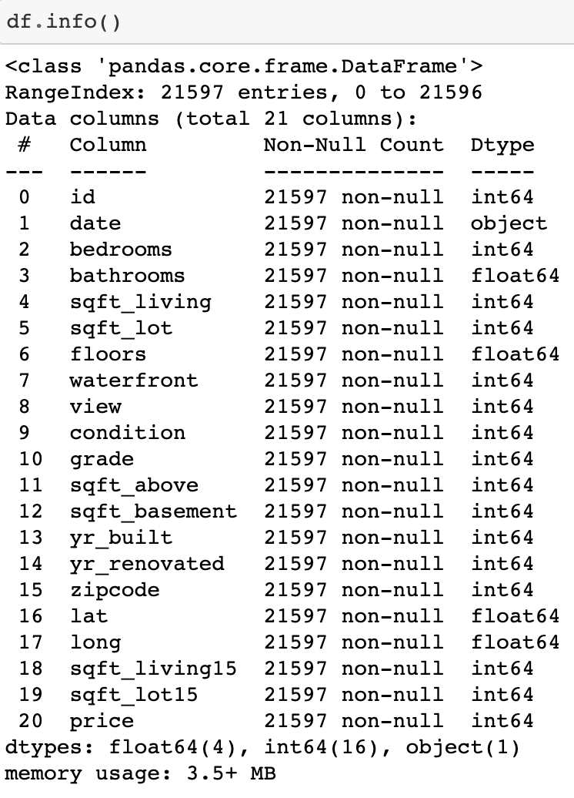
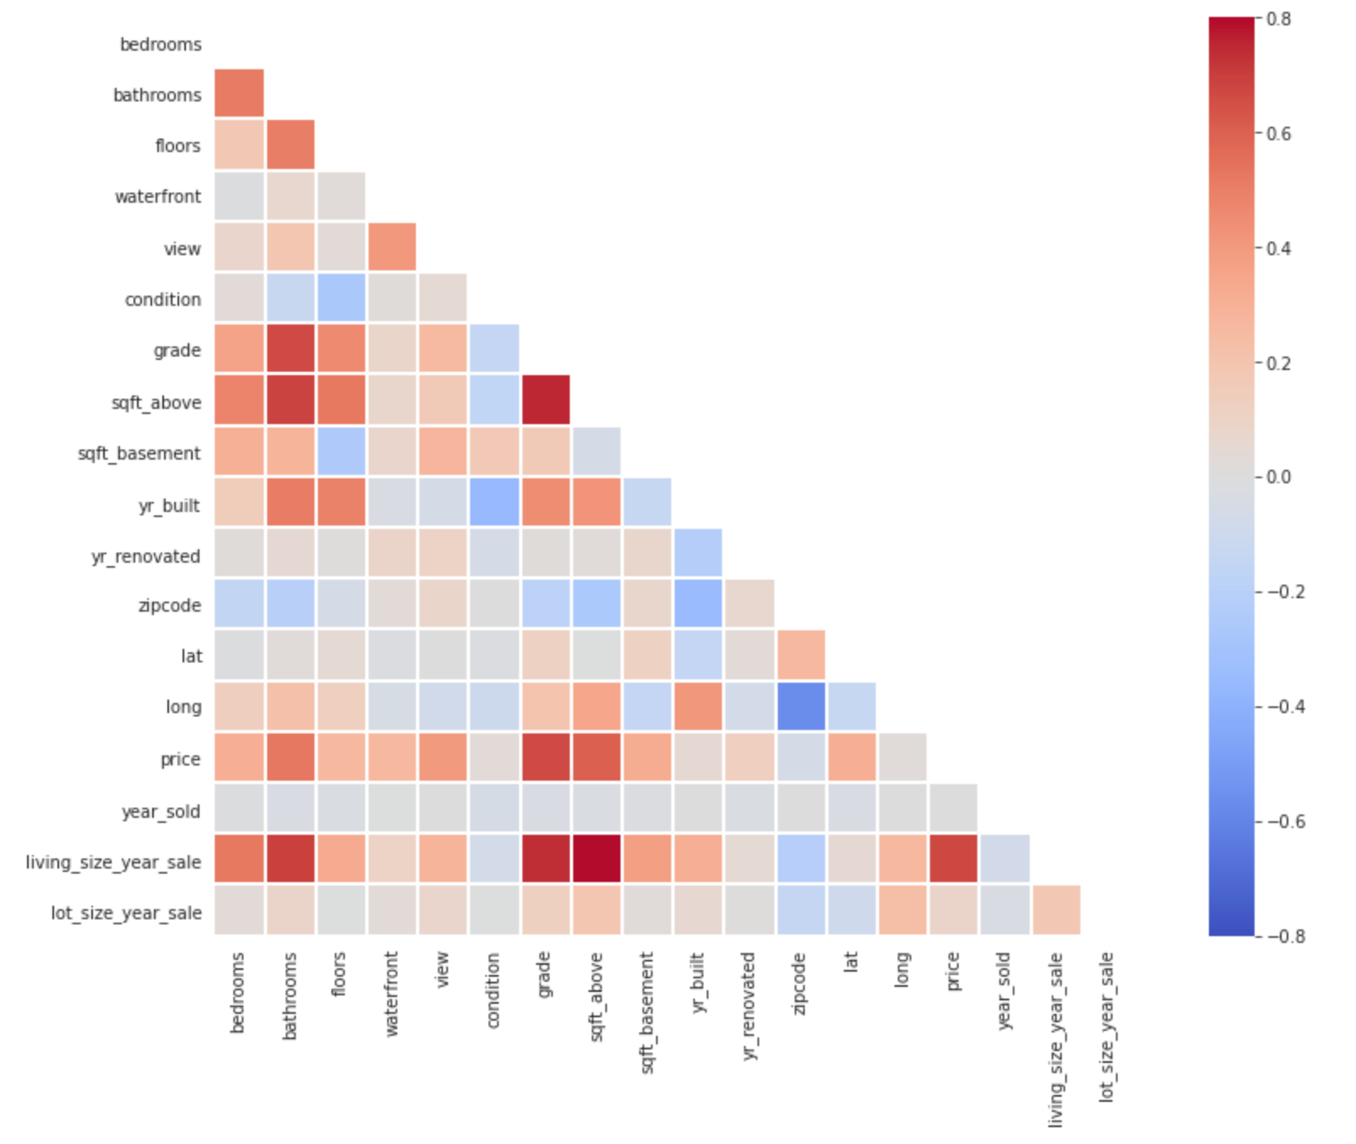
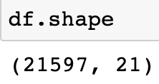
Data Exploration
By looking at the correlation matrix, I can already see some multicollinearity problems.
For example, between the “price” and the “grade”, the “sqft_above”, and between the “living_size_sale” and the “bathrooms”. This is the sign that more data exploration and wrangling will be needed.

Slide 3
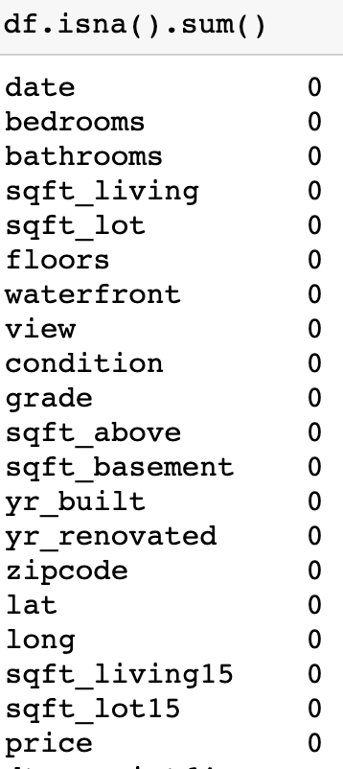
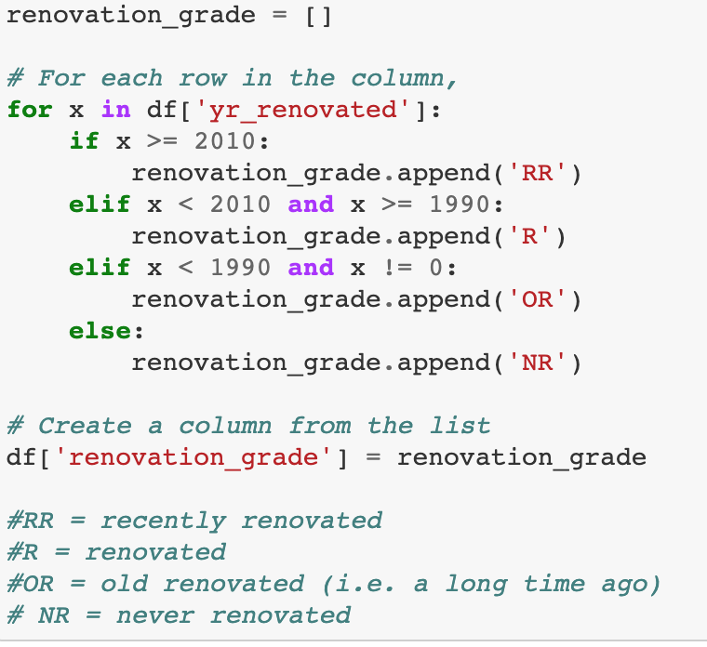
Data cleaning and wrangling
I find a lot of zeros in the model, but for a reason:
“waterfront” is a boolean = 1 or 0
“view” refers to zero for a very bad view
in “sqft_basement”, if it's zero, I assume there is no basement
“yr_renovated” - if it's zero, I assume it's never been renovated
As they all mean something, for now I do not delete or replace the zeros.
I decide to bin some values into categories to have a better understanding of the model.
New columns created:
‘renovation_grade’
‘basement_grade’
‘general_grade’
‘living_size_year_sale’
‘lot_size_year_sale’
And some columns dropped:
‘sqft_living15’
‘Id’
‘sqft_lot15’
‘sqft_living’
‘long’
‘sqft_above’
‘grade’
‘sqft_basement’
‘year_sold’
‘zipcode’
‘condition’

Slide 4
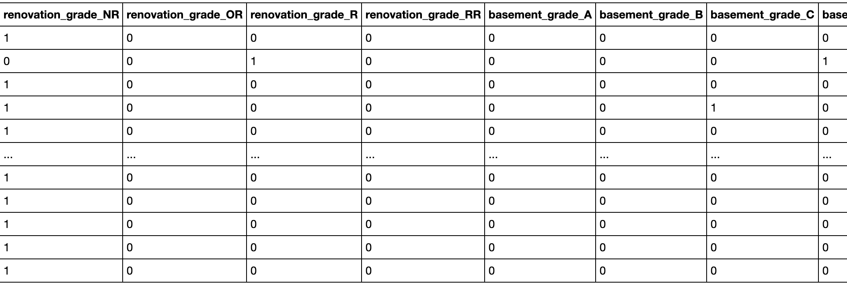
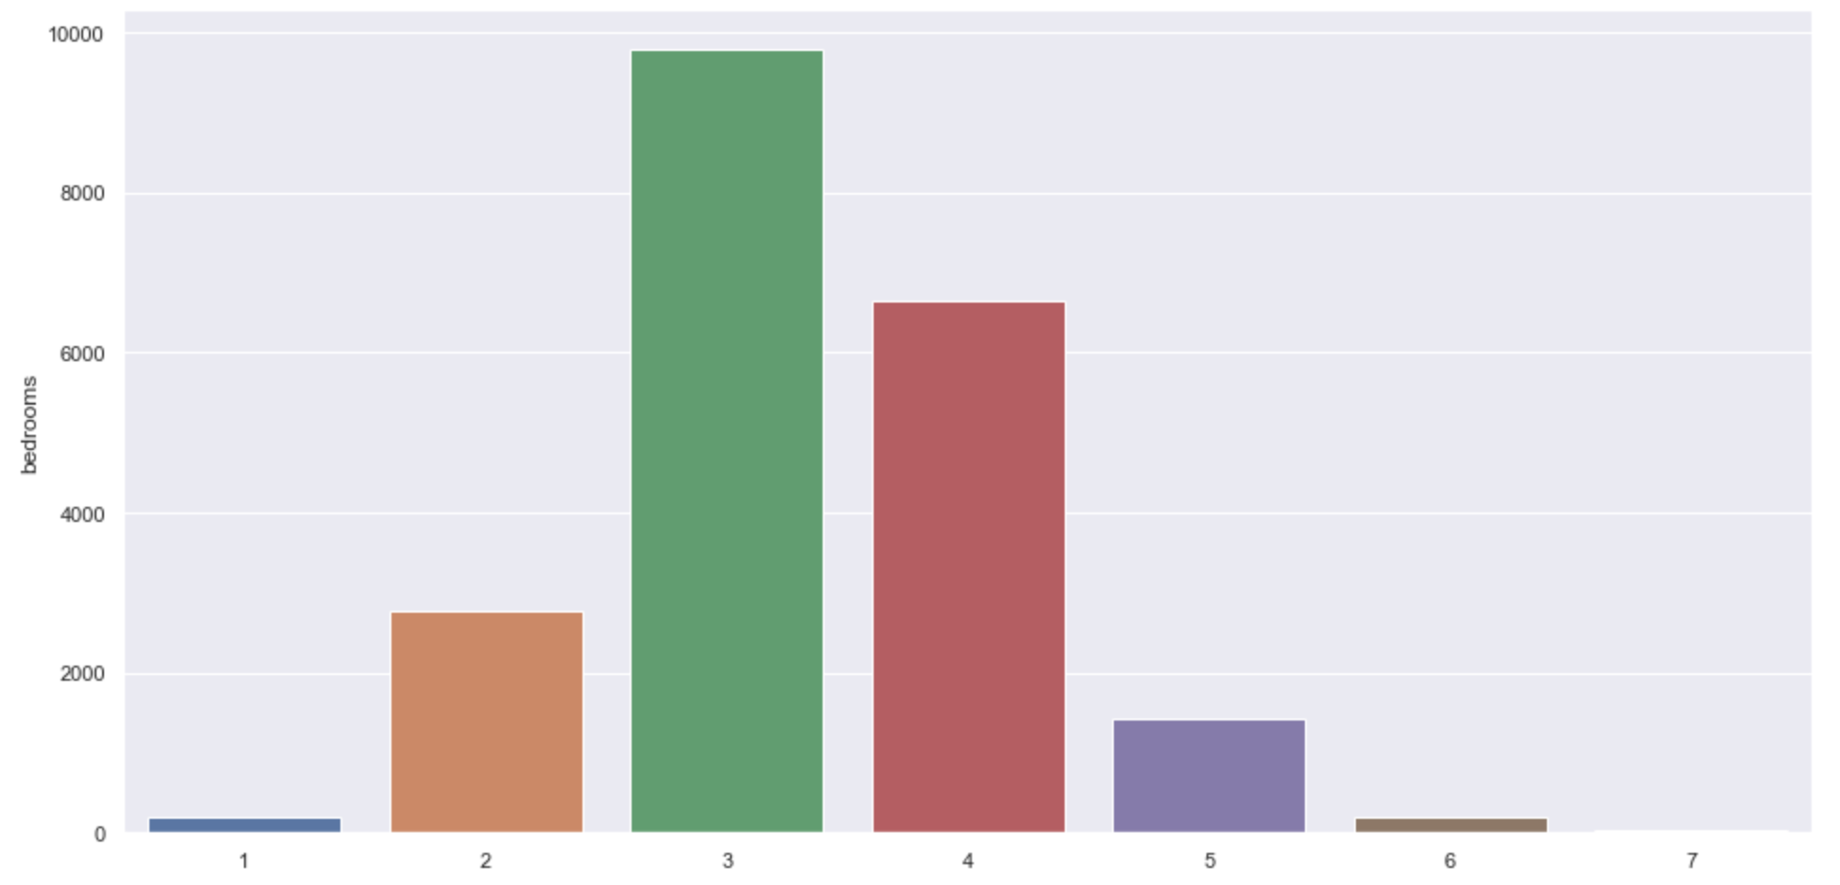
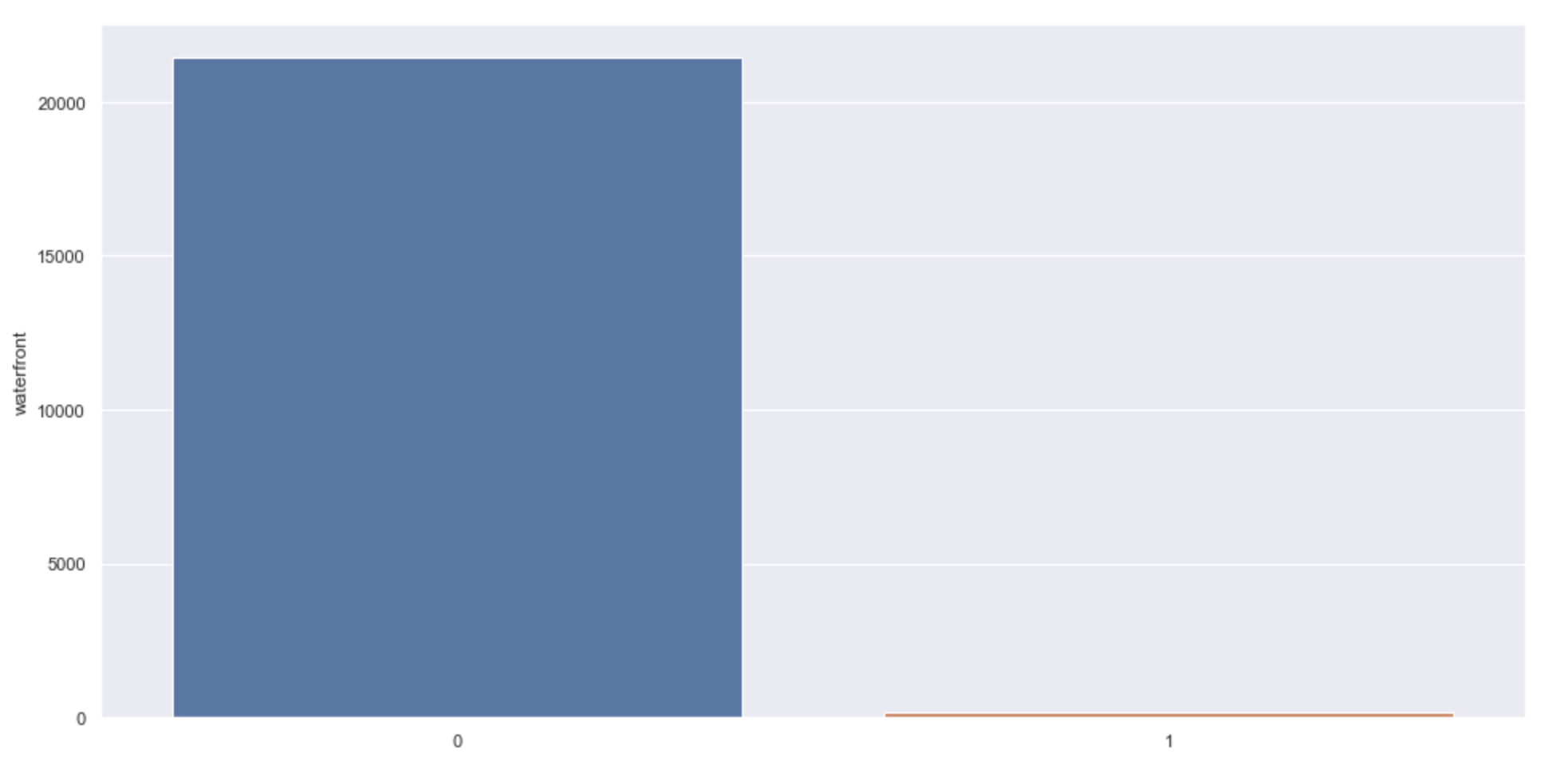
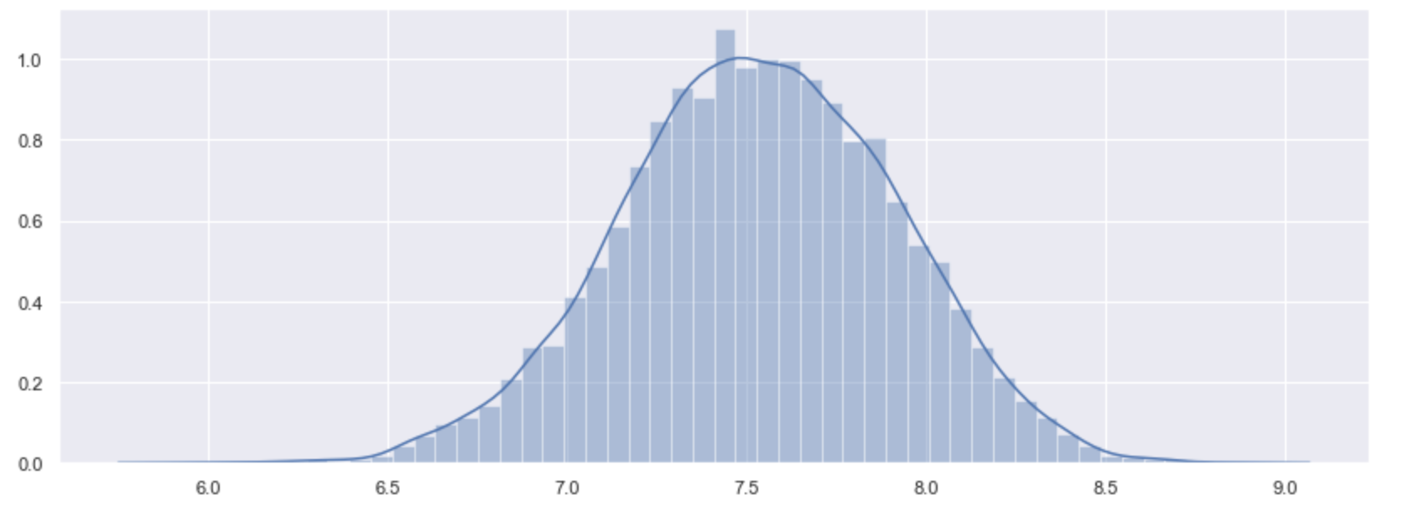
Boolean, log transformation, Dummy Variables and Outliers
After binning the old variables into different value buckets, I turn them into dummy variables to improve the regression.
The discrete variables present some outliers that need to be removed. For example, bedrooms=33. Moreover, I decide to turn “waterfront” into a boolean.
I turn the variable “waterfront” into a “true/False” boolean.
After proceeding with a log or squared transformation,
I also remove outliers from the continuous variables.

Slide 5
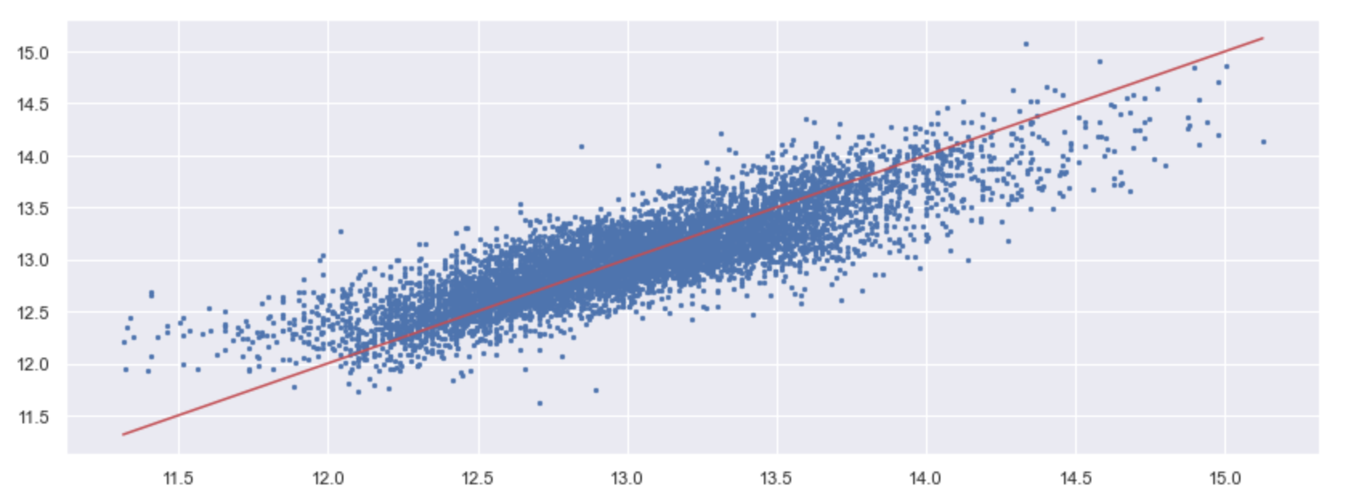
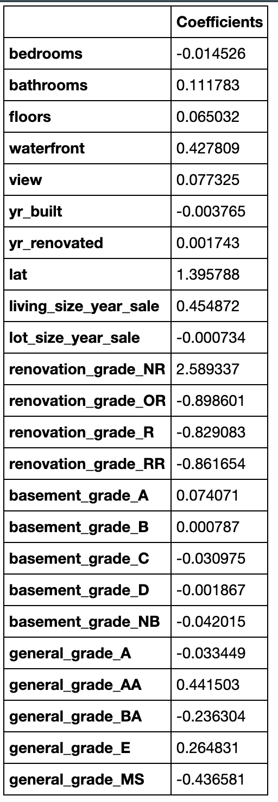
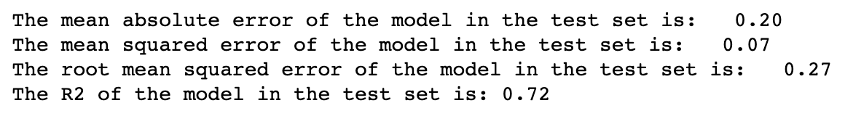
Machine Learning – Linear Regression Model
I divide the data between train and test variables, (60-40%) and proceed with a linear regression model that prints the following coefficients:
Conclusions:
“Waterfront”, “living size year by the time of the sale”, and the “general grade” have the strongest positive impact on the dependent variable. As they have fewer high values, this suggests also that they could have a high impact on the prices above 650000.
According to the results, the model seems to be a good fit. The MSE is pretty low, and the R2 shows that the independent variables in our model describe #our dependent variable quite efficiently, with 0.72 as a score.

